Slide 1
More Code Optimization
The material for this lecture is drawn, in part, from
The Practice of Programming (Kernighan & Pike) Chapter 7

Slide 2
Outline
Tuning Performance
Suggested reading
  5.14

Slide 3
Performance Improvement Pros
Techniques described in this lecture can yield answers to questions such as:
  How slow is my program?
  Where is my program slow?
  Why is my program slow?
  How can I make my program run faster?
  How can I make my program use less memory?

Slide 4
Performance Improvement Cons
Techniques described in this lecture can yield code that:
  Is less clear/maintainable
  Might confuse debuggers
  Might contain bugs
    Requires regression testing
So…

Slide 5
When to Improve Performance
“The first principle of optimization is
don’t.
Is the program good enough already?
Knowing how a program will be used and the environment it runs in, is there any benefit to making it faster?”
    -- Brian W. Kernighan and Rob Pike

Slide 6
Improving Execution Efficiency
Steps to improve execution (time) efficiency:
  (1) Do timing studies
  (2) Identify hot spots
  (3) Use a better algorithm or data structure
  (4) Enable compiler speed optimization
  (5) Tune the code
Let’s consider one at a time…

Slide 7
Timing Studies
(1) Do timing studies
To time a program… Run a tool to time program execution: E.g., UNIX time command
Output:
  Real: Wall-clock time between program invocation and termination
  User: CPU time spent executing the program
  System: CPU time spent within the OS on the program’s behalf
But, which parts of the code are the most time consuming?
$ time sort < bigfile.txt > output.txt
real 0m12.977s
user 0m12.860s
sys 0m0.010s

Slide 8
Timing Studies (cont.)
To time parts of a program... Call a function to compute wall-clock time consumed
  E.g., Unix gettimeofday() function (time since Jan 1, 1970)
  Not defined by C90 standard
#include <sys/time.h>
struct timeval startTime;
struct timeval endTime;
double wallClockSecondsConsumed;
gettimeofday(&startTime, NULL);
<execute some code here>
gettimeofday(&endTime, NULL);
wallClockSecondsConsumed =
endTime.tv_sec - startTime.tv_sec +
1.0E-6 * (endTime.tv_usec - startTime.tv_usec);
Notes:
UNIX time is relative to 00:00:00 UTC on January 1, 1970
UTC is Coordinated Universal Time (i.e., GMT)

Slide 9
Timing Studies (cont.)
To time parts of a program... Call a function to compute CPU time consumed
  E.g. clock() function
  Defined by C90 standard
#include <time.h>
clock_t startClock;
clock_t endClock;
double cpuSecondsConsumed;
startClock = clock();
<execute some code here>
endClock = clock();
cpuSecondsConsumed =
((double)(endClock - startClock)) / CLOCKS_PER_SEC;

Slide 10
Identify Hot Spots
(2) Identify hot spots
Gather statistics about your program’s execution
  How much time did execution of a function take?
  How many times was a particular function called?
  How many times was a particular line of code executed?
  Which lines of code used the most time?
  Etc.
Principles: Amdahl’s Law

Slide 11
Amdahl’s Law
T_{new} = (1-α)T_{old} + (αT_{old})/k
= T_{old}[(1-α) + α/k]
S = T_{old} / T_{new} = 1/[(1-α) + α/k]
S∞ = 1/(1-α)

Slide 12
How? Using GPROF
Step 1: Instrument the program
gcc217 –pg prog.c –o prog.c
  Adds profiling code to mysort, that is…
  “Instruments” prog.c
Step 2: Run the program
prog.c
  Creates file gmon.out containing statistics
Step 3: Create a report
gprof prog.c > myreport
  Uses mysort and gmon.out to create textual report
Step 4: Examine the report
cat myreport

Slide 13
Examples
unix> gcc –O1 –pg prog.c –o prog
unix> ./prog file.txt generates a file gmon.out
unix> gprof prog analyze the data in gmon.out
Each line describes one function
  name: name of the function
  %time: percentage of time spent executing this function
  cumulative seconds: [skipping, as this isn’t all that useful]
  self seconds: time spent executing this function
  calls: number of times function was called (excluding recursive)
  self s/call: average time per execution (excluding descendents)
  total s/call: average time per execution (including descendents)
% cumulative self self total
time seconds seconds calls s/call s/call name
97.58 173.05 173.05 1 173.05 173.05 sort_words
2.36 177.24 4.19 965027 0.00 0.00 find_ele_rec
0.12 177.46 0.22 12511031 0.00 0.00 Strlen
Notes:
-pg let gcc do instrumentation.
What is s/call. What spent on each call.
Self: Called by itself ,
Total: called by itself and others.

Slide 14
How does gprof work?
Essentially, by randomly sampling the code as it runs
… and seeing what line is running, & what function it’s in
Interval counting
  Maintain a counter for each function
    Record the time spent executing this function
  Interrupted at regular time (1ms)
    Check which function is executing when interrupt occurs
    Increment the counter for this function
The calling information is quite reliable
By default, the timings for library functions are not shown
Notes:
Counter: cycle counter?
The calling information is quite reliable??
By default, the timings for library functions are not shown??

Slide 15
Program Example
Task
  Analyzing the n-gram statistics of a text document
    an n-gram is a sequence of n words occurring in a document
  reads a text file,
  creates a table of unique n-grams
    specifying how many times each one occurs
  sorts the n-grams in descending order of occurrence

Slide 16
Program Example
Steps
  Convert strings to lowercase
  Apply hash function
  Read n-grams and insert into hash table
    Mostly list operations
    Maintain counter for each unique n-gram
  Sort results
Data Set
  Collected works of Shakespeare
  965,028 total words, 23,706 unique
  N=2, called bigrams
  363,039 unique bigrams

Slide 17
Examples
unix> gcc –O1 –pg prog.c –o prog
unix> ./prog file.txt
unix> gprof prog
% cumulative self self total
time seconds seconds calls s/call s/call name
97.58 173.05 173.05 1 173.05 173.05 sort_words
2.36 177.24 4.19 965027 0.00 0.00 find_ele_rec
0.12 177.46 0.22 12511031 0.00 0.00 Strlen

Slide 18
Example
Ratio : 158655725/965027 = 164.4
The average length of a list in one hash bucket is 164
index time called name
158655725 find_ele_rec [5]
4.19 0.02 965027/965027 insert_string [4]
[5] 2.4 4.19 0.02 965027+158655725 find_ele_rec [5]
0.01 0.01 363039/363039 new_ele [10]
0.00 0.01 363039/363039 save_string [13]
158655725 find_ele_rec [5]

Slide 19
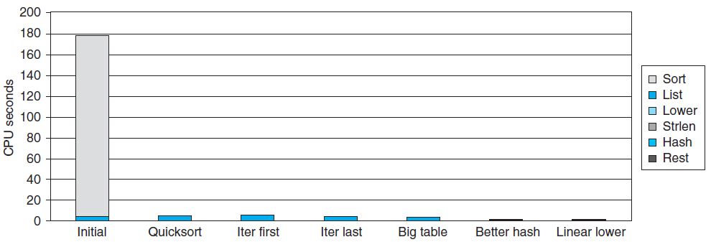
Code Optimizations
First step: Use more efficient sorting function
Library function qsort

Slide 20
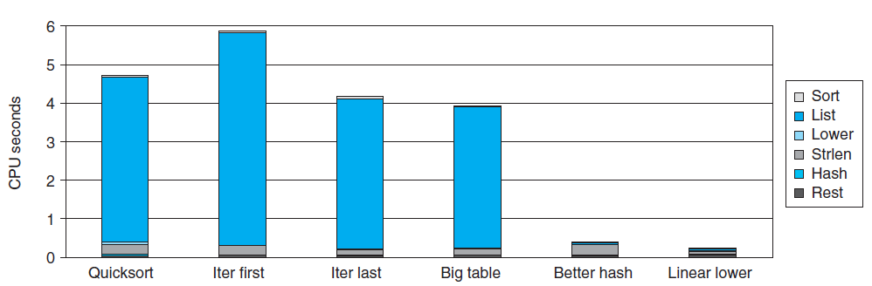
Further Optimizations

Slide 21
Optimizaitons
Replace recursive call to iterative
  Insert elements in linked list
  Causes code to slow down
Reason:
  Iter first: insert a new element at the beginning of the list
  Most common n-grams tend to appear at the end of the list which results the searching time
Iter last: iterative function, places new entry at end of the list
  Tend to place most common words at front of list

Slide 22
Optimizaitons
Big table: Increase number of hash
  Initial version: only 1021 buckets.
  There are 363039/1021 = 355.6 bigrams in each bucket
  Increase it to 199,999
  Only improves 0.3s
  Initial summing character codes for a string.
  The maximum code is 3371 for “honorificabilitudinitatibus thou”.
  Most buckets are not used

Slide 23
Optimizaitons
Better hash: Use more sophisticated hash function
  Shift and Xor
  Time drops to 0.4 seconds
Linear lower: Move strlen out of loop
  Time drops to 0.2 seconds

Slide 24
Code Motion
1 /* Convert string to lowercase: slow */
2 void lower1(char *s)
3 {
4 int i;
5
6 for (i = 0; i < strlen(s); i++)
7 if (s[i] >= ’A’ && s[i] <= ’Z’)
8 s[i] -= (’A’ - ’a’);
9 }
10

Slide 25
Code Motion
11 /* Convert string to lowercase: faster */
12 void lower2(char *s)
13 {
14 int i;
15 int len = strlen(s);
16
17 for (i = 0; i < len; i++)
18 if (s[i] >= ’A’ && s[i] <= ’Z’)
19 s[i] -= (’A’ - ’a’);
20 }
21

Slide 26
Code Motion
22 /* Sample implementation of library function strlen */
23 /* Compute length of string */
24 size_t strlen(const char *s)
25 {
26 int length = 0;
27 while (*s != ’\0’) {
28 s++;
29 length++;
30 }
31 return length;
32 }

Slide 27
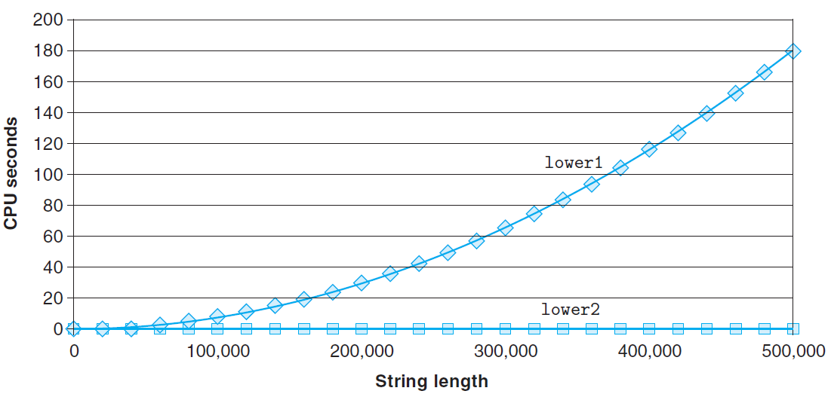
Code Motion

Slide 28
Performance Tuning
Benefits
  Helps identify performance bottlenecks
  Especially useful when have complex system with many components
Limitations
  Only shows performance for data tested
  E.g., linear lower did not show big gain, since words are short
    Quadratic inefficiency could remain lurking in code
  Timing mechanism fairly crude
    Only works for programs that run for > 3 seconds

Slide 29
Modern Processors &
More Code Optimization

Slide 30
Outline
Understanding Modern Processor
  Super-scalar
  Out-of –order execution
Loop Unrolling
Suggested reading
  5.7, 5.8

Slide 31
Modern Processor (review)
Superscalar
  Perform multiple operations on every clock cycle
  Instruction level parallelism
Out-of-order execution
  The order in which the instructions execute need not correspond to their ordering in the assembly program

Slide 32
Instruction Control
Fetch
Control
Address
Instruction
Cache
Retirement
Unit
Instruction
Decode
Instructions
Register
File
Operations
Register Updates
Prediction OK?
Execution
Functional
Units
Integer/
Branch
General
Integer
FP
Add
FP
Mult/Div
Load
Store
Operation Results
Addr.
Addr.
Data
Data
Data
Cache

Slide 33
Modern Processor (review)
Two main parts
  Instruction Control Unit (ICU)
    Responsible for reading a sequence of instructions from memory
    Generating from above instructions a set of primitive operations to perform on program data
  Execution Unit (EU)
    Execute these operations

Slide 34
Instruction Control Unit (review)
Instruction Cache
  A special, high speed memory containing the most recently accessed instructions.
Instruction Control
Fetch
Control
Address
Instruction
Cache
Retirement
Unit
Register
File
Instruction
Decode
Instructions
Operations
Register Updates
Prediction OK?

Slide 35
Instruction Control Unit (review)
Fetch Control
  Fetches ahead of currently accessed instructions
    enough time to decode instructions and send decoded operations down to the EU
Instruction Control
Fetch
Control
Address
Instruction
Cache
Retirement
Unit
Register
File
Instruction
Decode
Instructions
Operations
Register Updates
Prediction OK?

Slide 36
Fetch Control (review)
Branch Predication
  Branch taken or fall through
  Guess whether branch is taken or not
Speculative Execution
  Fetch, decode and execute only according to the branch prediction
  Before the branch predication has been determined whether or not

Slide 37
Instruction Control Unit (review)
Instruction Decoding Logic
  Take actual program instructions
Instruction Control
Fetch
Control
Address
Instruction
Cache
Retirement
Unit
Register
File
Instruction
Decode
Instructions
Operations
Register Updates
Prediction OK?

Slide 38
Instruction Control Unit (review)
Instruction Decoding Logic
  Take actual program instructions
  Converts them into a set of primitive operations
    An instruction can be decoded into a variable number of operations
  Each primitive operation performs some simple task
    Simple arithmetic, Load, Store
  Register renaming
addl %eax, 4(%edx)
    load 4(%edx) → t1
    addl %eax, t1 → t2
    store t2, 4(%edx)

Slide 39
Execution Unit (review)
Multi-functional Units
  Receive operations from ICU
  Execute a number of operations on each clock cycle
  Handle specific types of operations
Execution
Functional
Units
Integer/
Branch
General
Integer
FP
Add
FP
Mult/Div
Load
Store
Operation Results
Addr.
Addr.
Data
Data
Data
Cache

Slide 40
Multi-functional Units (review)
Multiple Instructions Can Execute in Parallel
  Nehalem CPU (Core i7)
      1 load, with address computation
      1 store, with address computation
      2 simple integer (one may be branch)
      1 complex integer (multiply/divide)
      1 FP Multiply
      1 FP Add

Slide 41
Multi-functional Units (review)
Some Instructions Take > 1 Cycle, but Can be Pipelined
  Nehalem (Core i7)
  Instruction Latency Cycles/Issue
    Integer Add 1 0.33
    Integer Multiply 3 1
    Integer/Long Divide 11--21 5--13
    Single/Double FP Add 3 1
    Single/Double FP Multiply 4/5 1
    Single/Double FP Divide 10--23 6--19

Slide 42
Execution Unit
Operation is dispatched to one of multi-functional units, whenever
  All the operands of an operation are ready
  Suitable functional units are available
Execution results are passed among functional units

Slide 43
Execution Unit
Data Cache
  Load and store units access memory via data cache
  A high speed memory containing the most recently accessed data values
Execution
Functional
Units
Integer/
Branch
General
Integer
FP
Add
FP
Mult/Div
Load
Store
Operation Results
Addr.
Addr.
Data
Data
Data
Cache

Slide 44
Instruction Control Unit
Retirement Unit
  Keep track of the ongoing processing
  Obey the sequential semantics of the machine-level program (misprediction & exception)
Instruction Control
Fetch
Control
Address
Instruction
Cache
Retirement
Unit
Instruction
Decode
Instructions
Register
File
Operations
Register Updates
Prediction OK?

Slide 45
Instruction Control Unit
Register File
  Integer, floating-point and other registers
  Controlled by Retirement Unit
Instruction Control
Fetch
Control
Address
Instruction
Cache
Retirement
Unit
Register
File
Instruction
Decode
Instructions
Operations
Register Updates
Prediction OK?

Slide 46
Instruction Control Unit
Instruction Retired/Flushed
  Place instructions into a first-in, first-out queue
  Retired: any updates to the registers being made
    Operations of the instruction have completed
    Any branch prediction to the instruction are confirmed correctly
  Flushed: discard any results have been computed
    Some branch prediction was mispredicted
    Mispredictions can’t alter the program state

Slide 47
Execution Unit
Operation Results
  Functional units can send results directly to each other
  A elaborate form of data forwarding techniques
Execution
Functional
Units
Integer/
Branch
General
Integer
FP
Add
FP
Mult/Div
Load
Store
Operation Results
Addr.
Addr.
Data
Data
Data
Cache

Slide 48
Execution Unit
Register Renaming
  Values passed directly from producer to consumers
  A tag t is generated to the result of the operation
    E.g. %ecx.0, %ecx.1
  Renaming table
    Maintain the association between program register r and tag t for an operation that will update this register

Slide 49
Translation Example
Example
  combine4 (data_t = float, OP = *)
void combine4(vec_ptr v, data_t *dest)
{
long int i;
long int length = vec_length(v);
data_t *data = get_vec_start(v);
data_t x = IDENT;
for (i = 0; i < length; i++)
x = x OP data[i];
*dest = x;
}

Slide 50
Translation Example
.L488: # Loop:
mulss (%rax,%rdx,4),%xmm0 # t *= data[i]
addq $1, %rdx # Increment i
cmpq %rdx,%rbp # Compare length:i
jg .L488 # if > goto Loop
load (%rax,%rdx.0,4)➔ t.1
mulq t.1, %xmm0.0 ➔ %xmm0.1
addq $1, %rdx.0 ➔ %rdx.1
cmpq %rdx.1, %rbp ➔ cc.1
jg-taken cc.1

Slide 51
Understanding Translation Example
mulss (%rax,%rdx,4),%xmm0
load (%rax,%rdx.0,4)➔ t.1
mulq t.1, %xmm0.0 ➔ %xmm0.1
Split into two operations
  Load reads from memory to generate temporary result t.1
  Multiply operation just operates on registers

Slide 52
Understanding Translation Example
mulss (%rax,%rdx,4),%xmm0
load (%rax,%rdx.0,4)➔ t.1
mulq t.1, %xmm0.0 ➔ %xmm0.1
Operands
  Registers %rax does not change in loop
  Values will be retrieved from register file during decoding

Slide 53
Understanding Translation Example
mulss (%rax,%rdx,4),%xmm0
load (%rax,%rdx.0,4)➔ t.1
mulq t.1, %xmm0.0 ➔ %xmm0.1
Operands
  Register %xmm0 changes on every iteration
  Uniquely identify different versions as
    %xmm0.0, %xmm0.1, %xmm0.2, …
  Register renaming
    Values passed directly from producer to consumers

Slide 54
Understanding Translation Example
addq $1, %rdx
addq $1, %rdx.0 ➔ %rdx.1
Register %rdx changes on each iteration
Renamed as %rdx.0, %rdx.1, %rdx.2, …

Slide 55
Understanding Translation Example
cmpq %rdx,%rbp
cmpq %rdx.1, %rbp ➔ cc.1
Condition codes are treated similar to registers
Assign tag to define connection between producer and consumer

Slide 56
Understanding Translation Example
jg .L488
jg-taken cc.1
Instruction control unit determines destination of jump
Predicts whether target will be taken
Starts fetching instruction at predicted destination

Slide 57
Understanding Translation Example
jg .L488
jg-taken cc.1
Execution unit simply checks whether or not prediction was OK
If not, it signals instruction control unit
  Instruction control unit then “invalidates” any operations generated from misfetched instructions
  Begins fetching and decoding instructions at correct target

Slide 58
Data-Flow Graphs
Data-Flow Graphs
  Visualize how the data dependencies in a program dictate its performance
  Example: combine4 (data_t = float, OP = *)
void combine4(vec_ptr v, data_t *dest)
{
long int i;
long int length = vec_length(v);
data_t *data = get_vec_start(v);
data_t x = IDENT;
for (i = 0; i < length; i++)
x = x OP data[i];
*dest = x;
}

Slide 59
Graphical Representation
%rax
%rbp
%rdx
%xmm0
load
mulss (%rax,%rdx,4), %xmm0
mul
add
t
addq $1,%rdx
cmp
cmpq %rdx,%rbp
jg
jg loop
cc
%rax
%rbp
%rdx
%xmm0
Registers
  read-only: %rax, %rcx
  write-only: -
  Loop: %rdx, %xmm0
  Local: t, cc
load (%rax,%rdx.0,4)➔ t.1
mulq t.1, %xmm0.0 ➔ %xmm0.1
addq $1, %rdx.0 ➔ %rdx.1
cmpq %rdx.1, %rbp ➔ cc.1
jg-taken cc.1

Slide 60
Refinement of Graphical Representation
%rax
%rbp
%rdx
%xmm0
Data Dependencies
load
mul
add
cmp
%xmm0
%rax
%rbp
%rdx
jg
%rax
%rbp
%rdx
%xmm0
load
add
mul
cmp
jg
%xmm0
%rdx

Slide 61
Refinement of Graphical Representation
%xmm0
%rdx
Data Dependencies
load
data[i]
add
mul
%xmm0
%rax
%rbp
%rdx
%xmm0
%rdx
load
add
mul
cmp
jg
%xmm0
%rdx

Slide 62
Refinement of Graphical Representation
%xmm0
%rdx
%xmm0.0
%rdx.0
load
data[i]
load
data[0]
add
add
mul
mul
%xmm0
%rdx
%xmm0.1
%rdx.1
load
data[1]
add
mul
%xmm0.2
%rdx.2

Slide 63
Refinement of Graphical Representation
load
data[0]
%xmm0.0
%rdx.0
add
mul
load
data[0]
add
mul
load
data[1]
add
%xmm0.1
%rdx.1
mul
load
data[1]
..
..
add
mul
load
data[n-1]
add
%xmm0.2
%rdx.2
mul

Slide 64
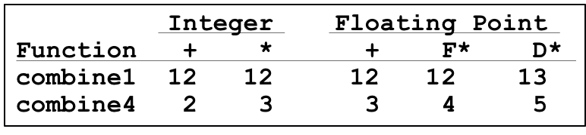
Refinement of Graphical Representation
data[0]
Two chains of data dependencies
  Update x by mul
  Update i by add
Critical path
  Latency of mul is 4
  Latency of add is 1
The latency of combine4 is 4
load
add
mul
load
data[1]
add
mul
..
..
load
data[n-1]
add
mul

Slide 65
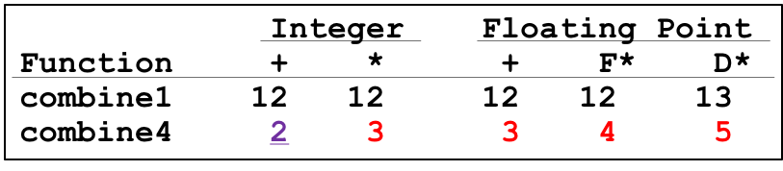
Performance-limiting Critical Path
  Nehalem (Core i7)
  Instruction Latency Cycles/Issue
    Integer Add 1 0.33
    Integer Multiply 3 1
    Integer/Long Divide 11--21 5--13
    Single/Double FP Add 3 1
    Single/Double FP Multiply 4/5 1
    Single/Double FP Divide 10--23 6--19

Slide 66
Other Performance Factors
Data-flow representation provide only a lower bound
  e.g. Integer addition, CPE = 2.0
  Total number of functional units available
  The number of data values can be passed among functional units
Next step
  Enhance instruction-level parallelism
  Goal: CPEs close to 1.0

Slide 67
Loop Unrolling
void combine5(vec_ptr v, int *dest)
{
int i;
int length = vec_length(v);
int limit = length - 2;
int *data = get_vec_start(v);
int x = IDENT;
/* combine 3 elements at a time */
for (i = 0; i < limit; i+=3)
x = x OPER data[i] OPER data[i+1] OPER data[i+2];
/* finish any remaining elements */
for (; i < length; i++)
x = x OPER data[i];
*dest = x;
}

Slide 68
Translation
Loads can pipeline, since don’t have dependencies
Only one set of loop control operations
load (%rax,%rdx.0,4) ➔ t.1a
addq t.1a, %rcx.0c ➔ %rcx.1a
load 4(%rax,%rdx.0,4) ➔ t.1b
addq t.1b, %rcx.1a ➔ %rcx.1b
load 8(%rax,%rdx.0,4) ➔ t.1c
addq t.1c, %rcx.1b ➔ %rcx.1c
addq $3,%rdx.0 ➔ %rdx.1
cmpq %rdx.1, %rbp ➔ cc.1
jg-taken cc.1

Slide 69
Graphical Representation
%rax
%rbp
%rdx
%xmm0
load
addq (%rax,%rdx,4), %xmm0
add
load
t.a
addq 4(%rax,%rdx,4), %xmm0
add
load
t.b
addq 8(%rax,%rdx,4), %xmm0
add
add
t.c
addq $3,%rdx
cmp
cmpq %rdx,%rbp
jg
jg loop
cc
%rax
%rbp
%rdx
%xmm0

Slide 70
Graphical Representation
%xmm0
%rax
%rbp
%rdx
%xmm0
%rdx
load
load
data[i]
add
add
load
data[i+1]
load
add
load
data[i+2]
add
add
add
load
add
add
%xmm0
%rdx
cmp
jg
%xmm0
%rdx

Slide 71
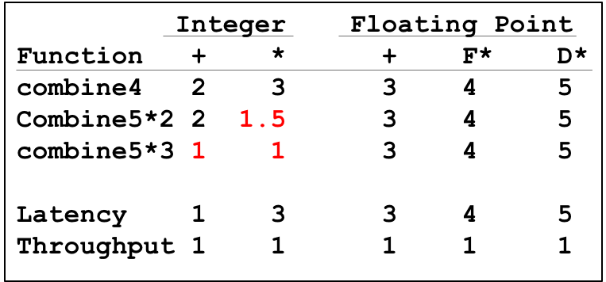
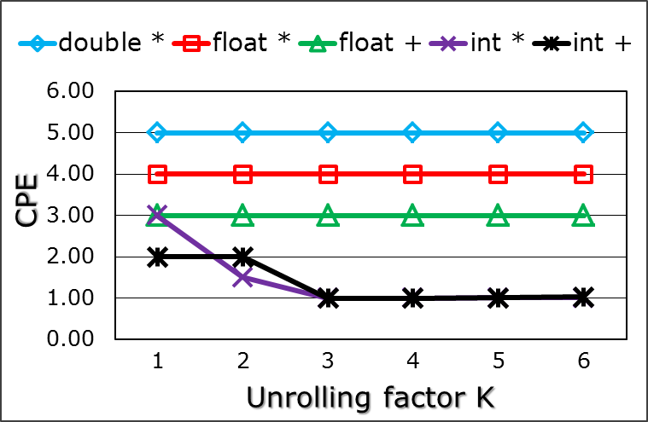
Graphical Representation
load
data[0]
add
load
data[1]
add
load
data[2]
add
add
load
data[3]
add
load
data[4]
add
load
data[5]
add
add

Slide 72
Loop Unrolling
Improve performance
  Reduces the number of operations
  (e.g. loop indexing and conditional branching)
  Transform the code to reduce the number of operations in the critical paths
CPEs for both integer ops improve
But for both floating-point ops do not

Slide 73
Effect of Unrolling
load
data[i]
load
data[i]
mul
add
load
data[i+1]
load
data[i+1]
add
load
data[i+2]
mul
add
add
load
data[i+2]
Critical path
  Latency of integer add is 1
  Latency of FP multiplex is 4
mul
add

Slide 74
Effect of Unrolling
Only helps integer sum for our examples
  Other cases constrained by functional unit latencies
Effect is nonlinear with degree of unrolling
  Many subtle effects determine exact scheduling of operations

